Slide 1
Discrete Mathematics
BCSC0010
Module 1
Generating Functions

Slide 2
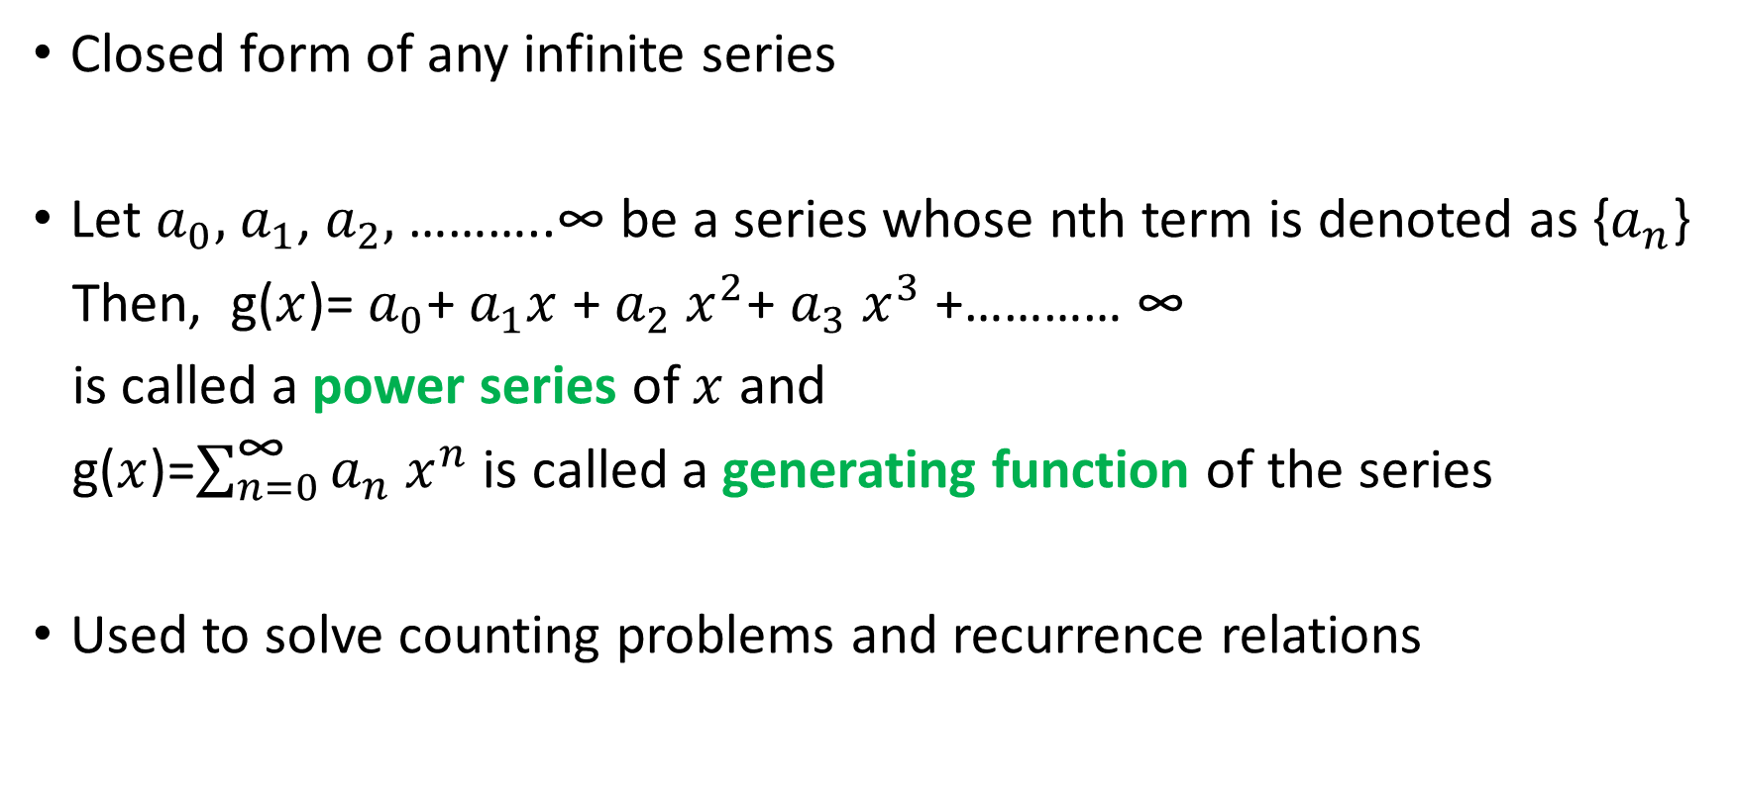
Generating Function
Closed form of any infinite series
Let $a_{0},$ $a_{1}$, $a_{2},$………..∞ be a series whose nth term is denoted as {$a_{n}$}
Then, g($x$)= $a_{0}$+ $a_{1}x$ + $a_{2} x^{2}$+ $a_{3} x^{3}$+………… ∞
is called a power series of $x$ and
g($x$)=$\sum_{n=0}^{\text{∞}}{a_{n} x^{n}}$ is called a generating function of the series
Used to solve counting problems and recurrence relations

Slide 3
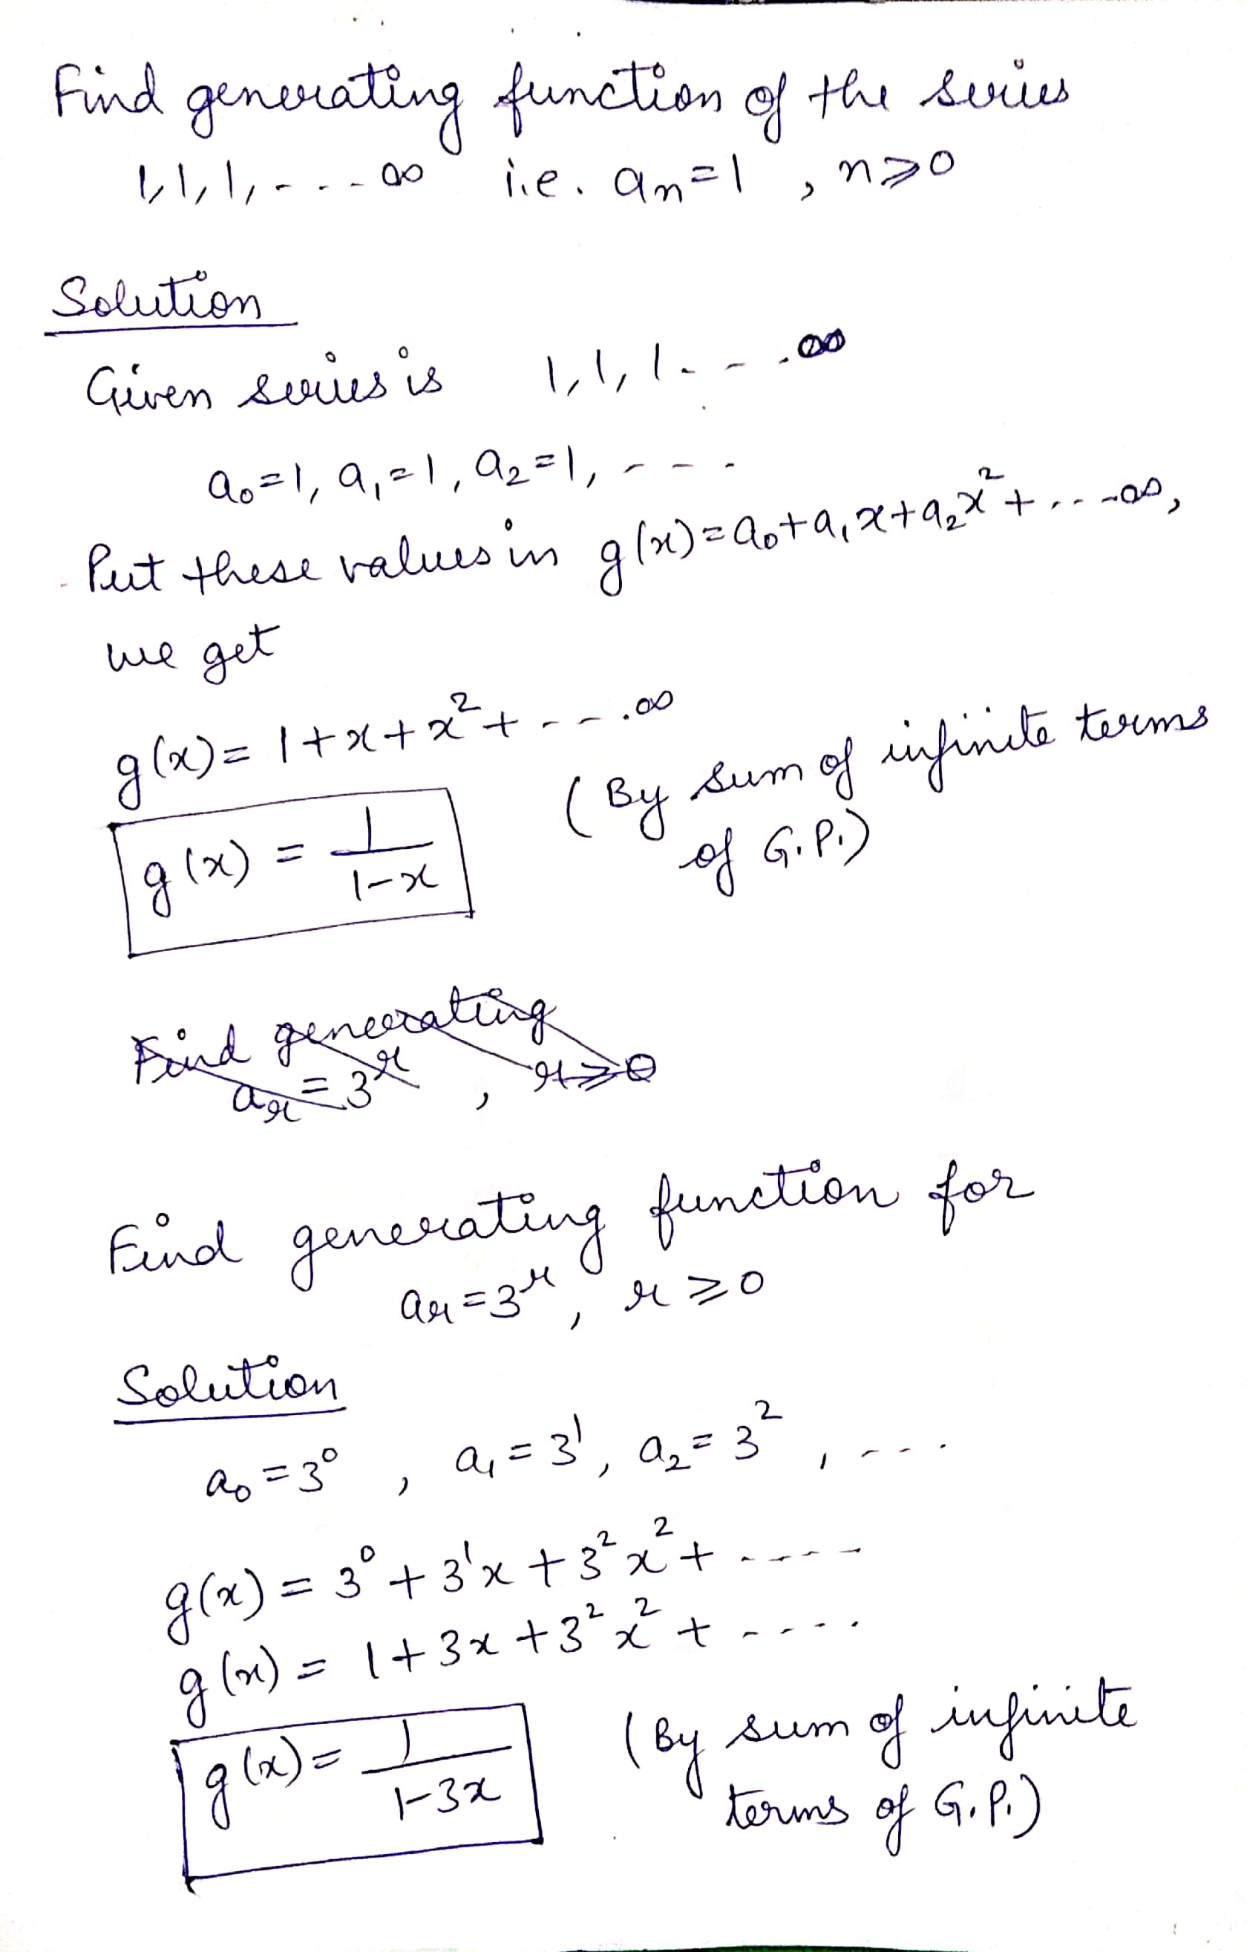
Example

Slide 4
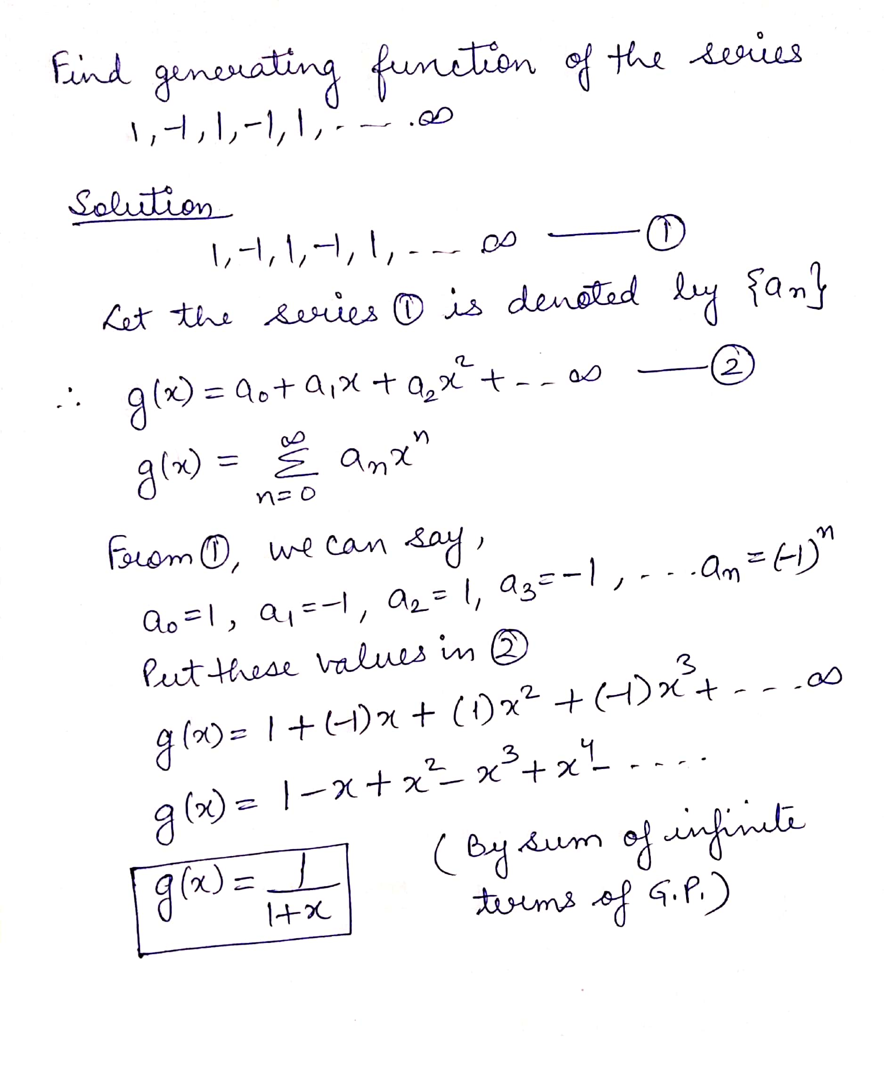
Example
contd..

Slide 6
Example

Slide 7
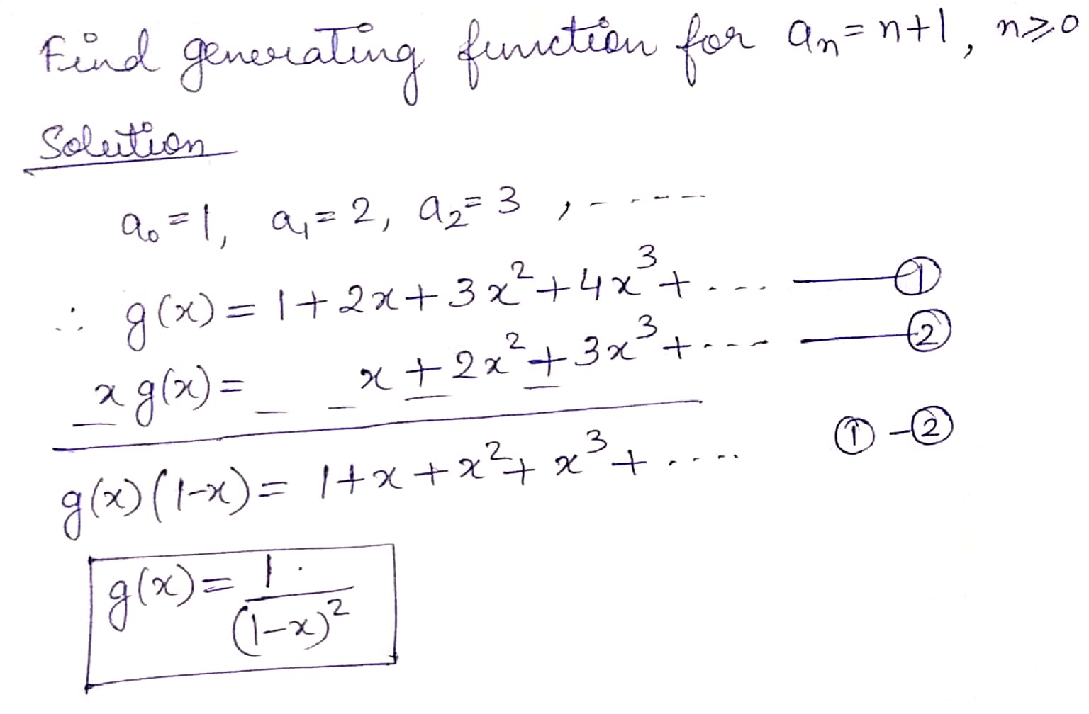
Example

Slide 8
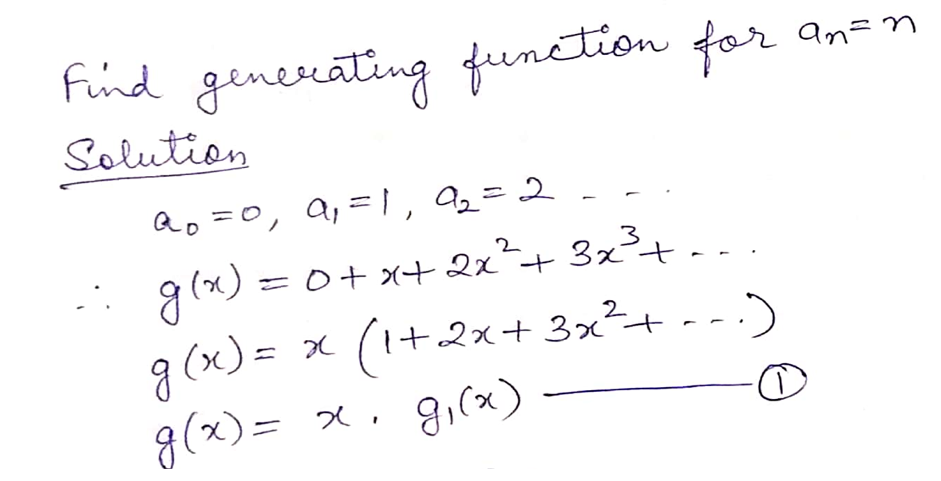
Example
contd..

Slide 9
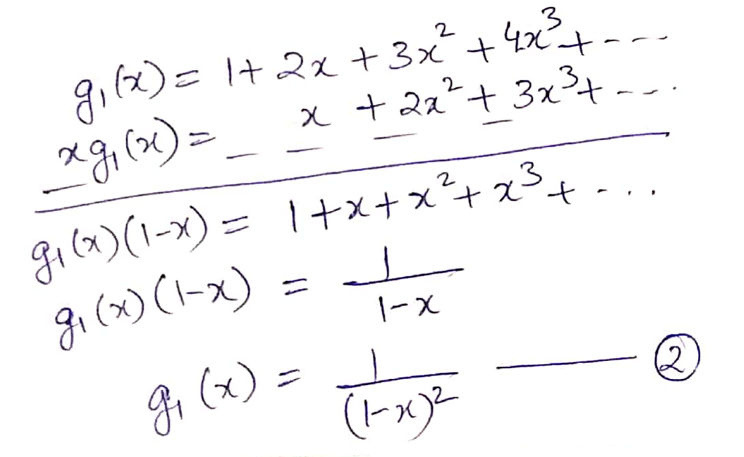
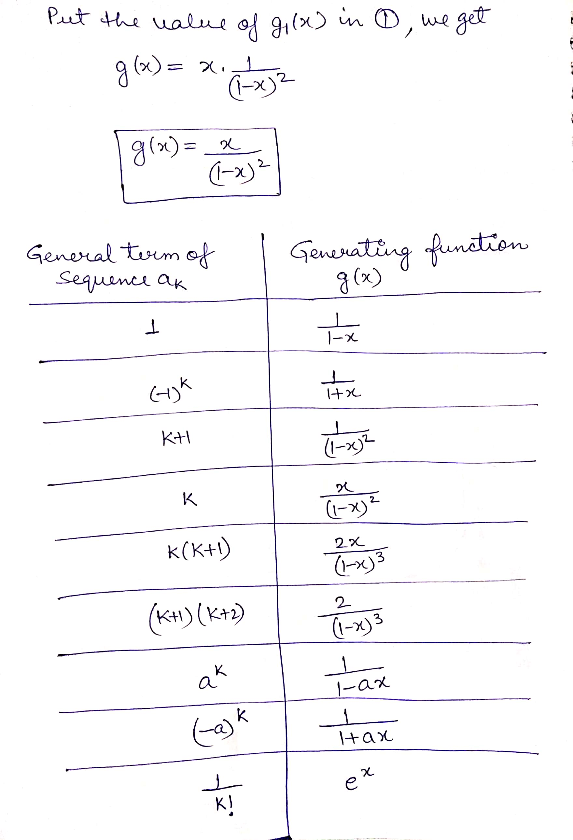

Slide 11
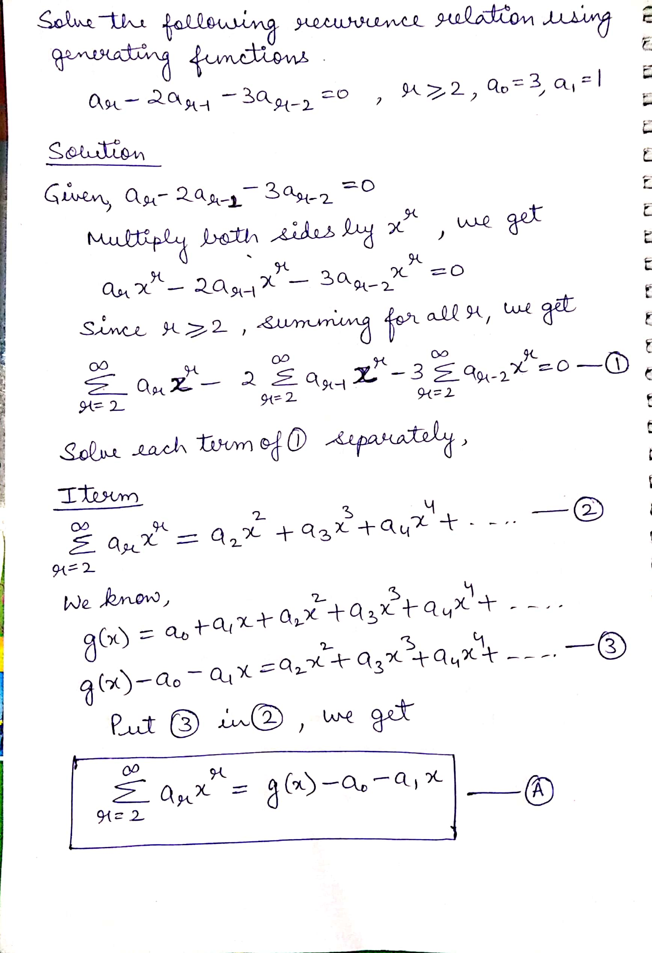
Example
contd..

Slide 12
contd..

Slide 13
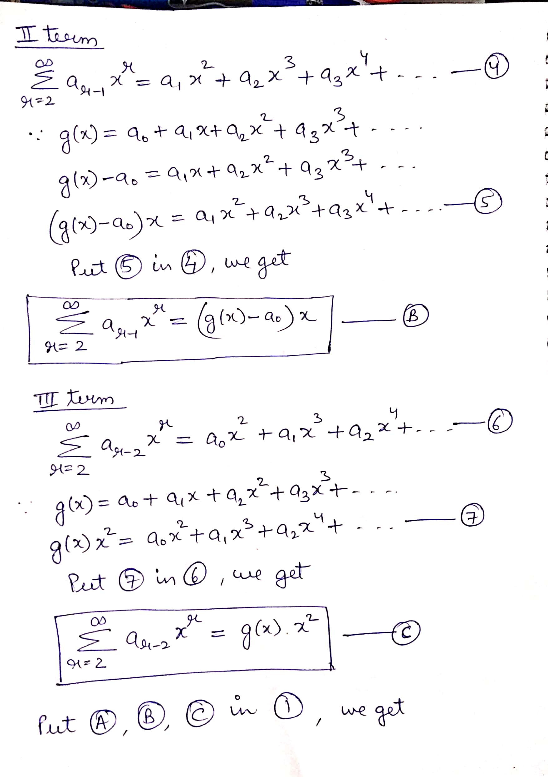
contd..

Slide 14
contd..

Slide 15
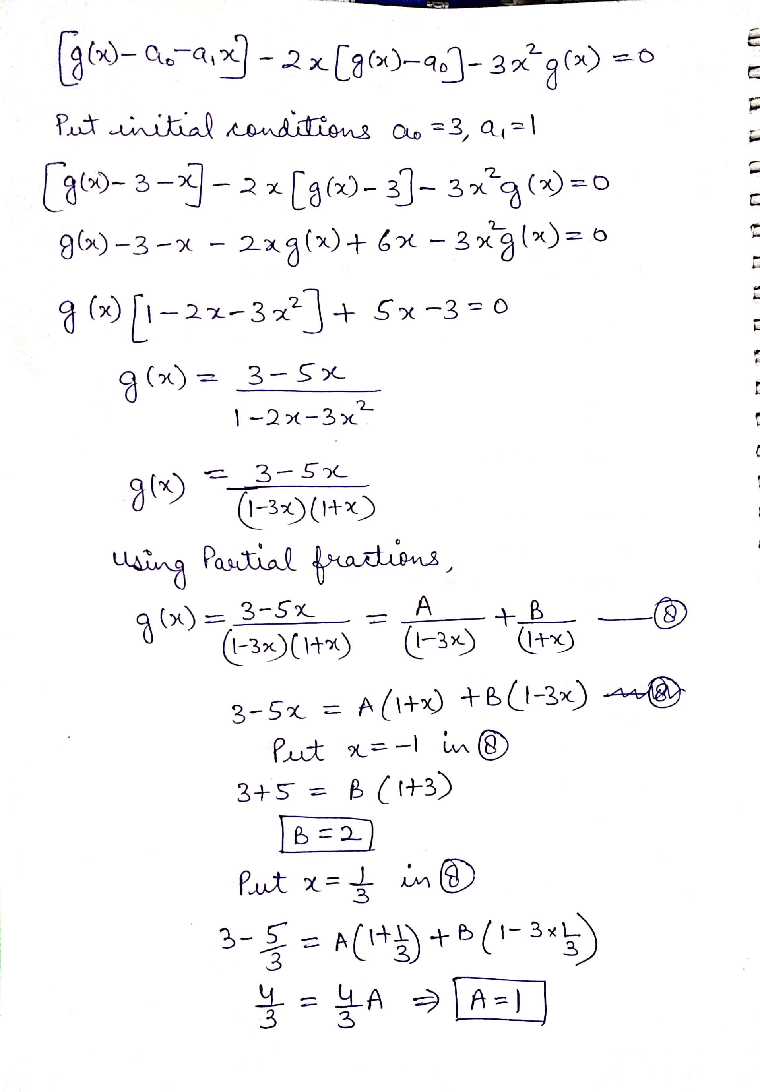
contd..

Slide 16
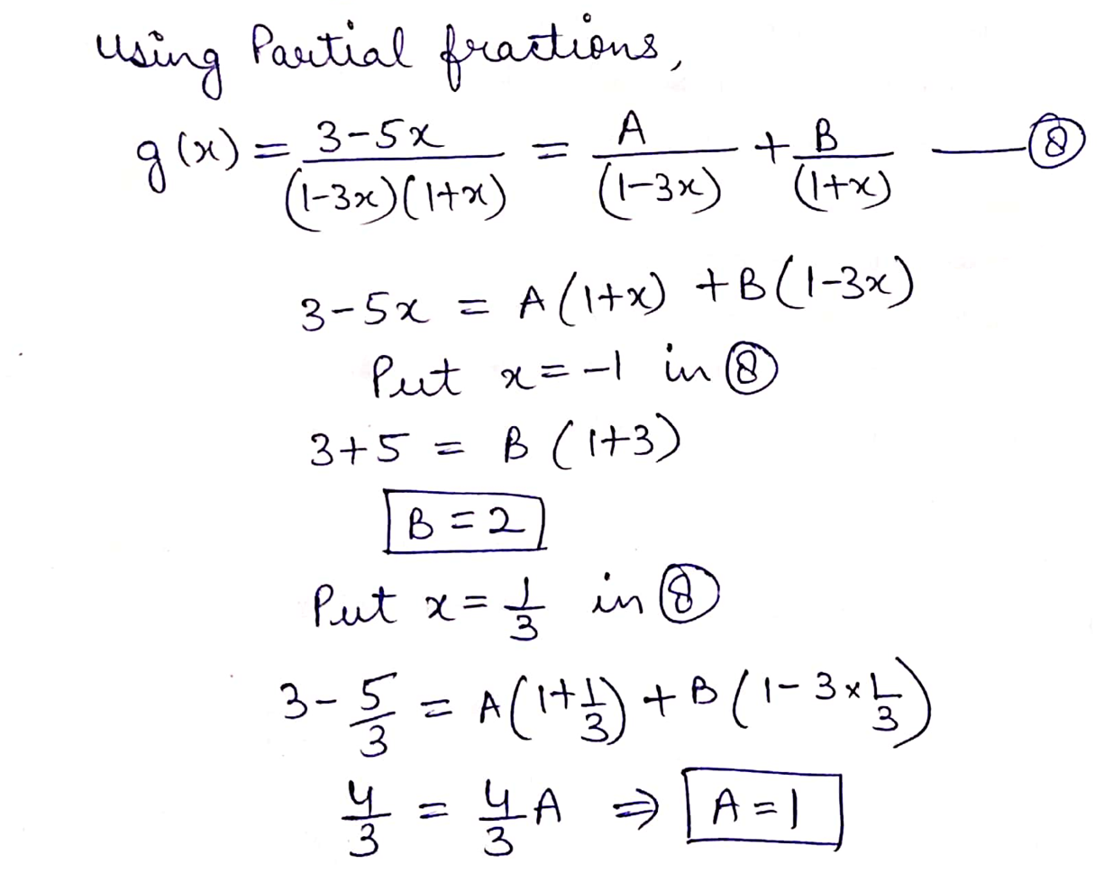
contd..

Slide 17
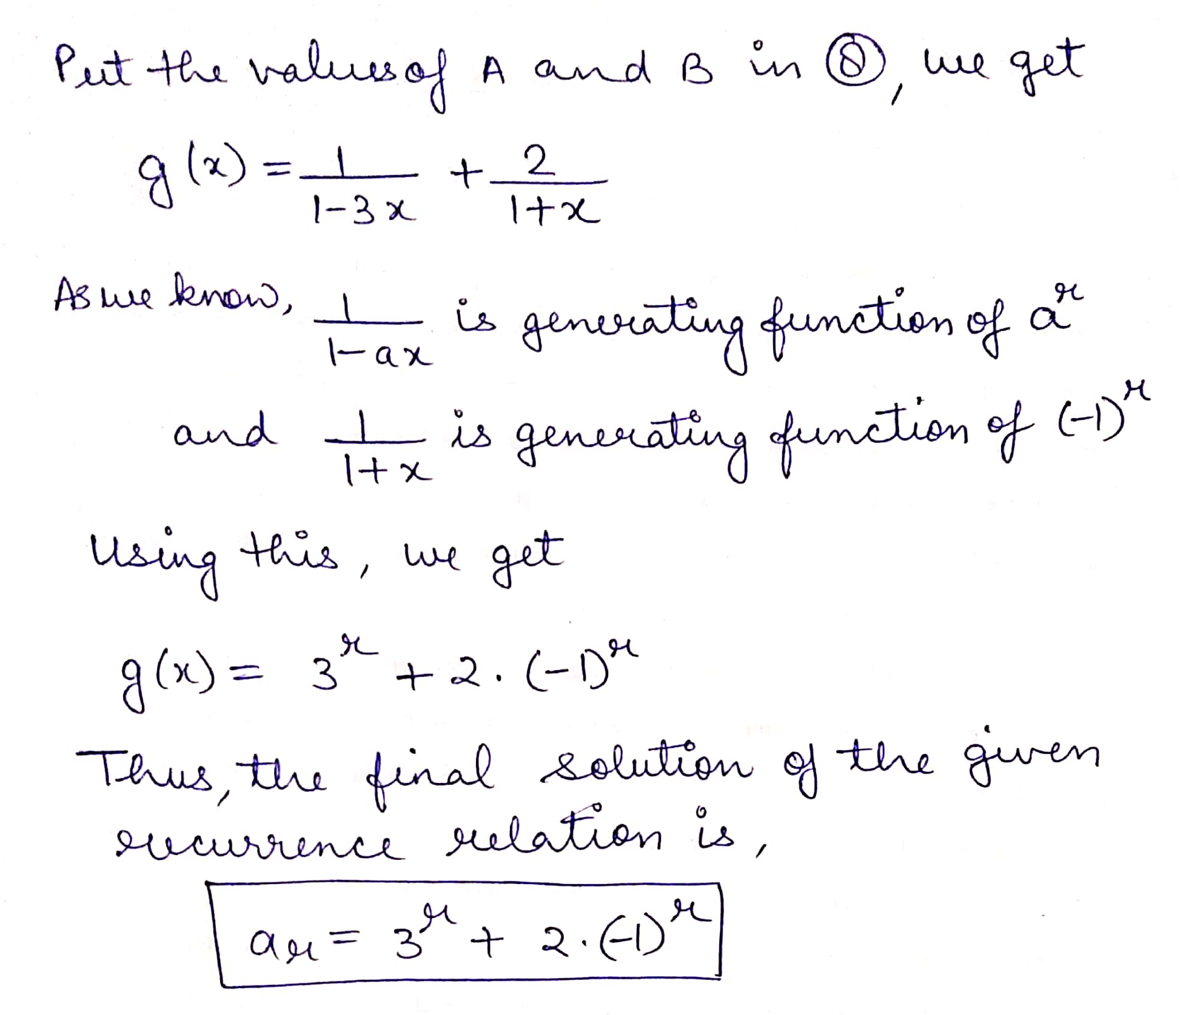

Slide 18
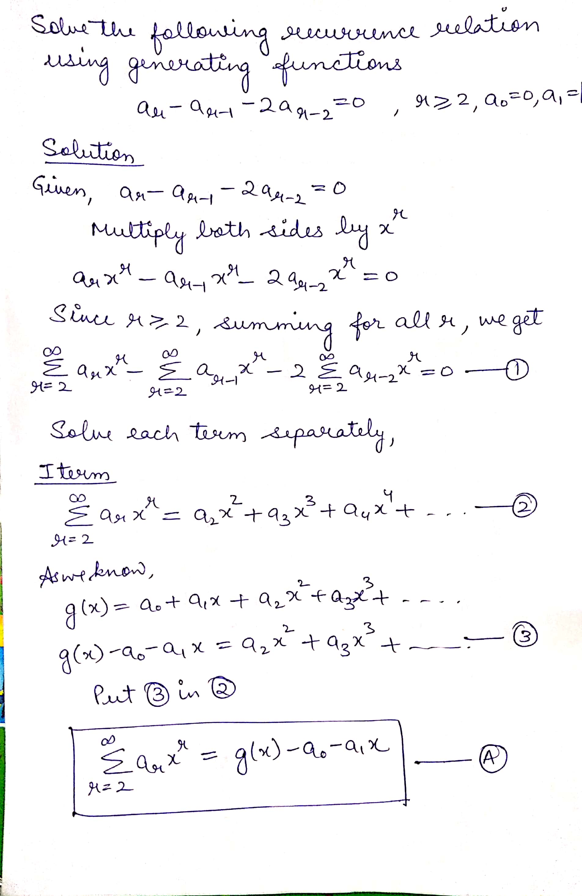
Example
contd..

Slide 19
contd..

Slide 20
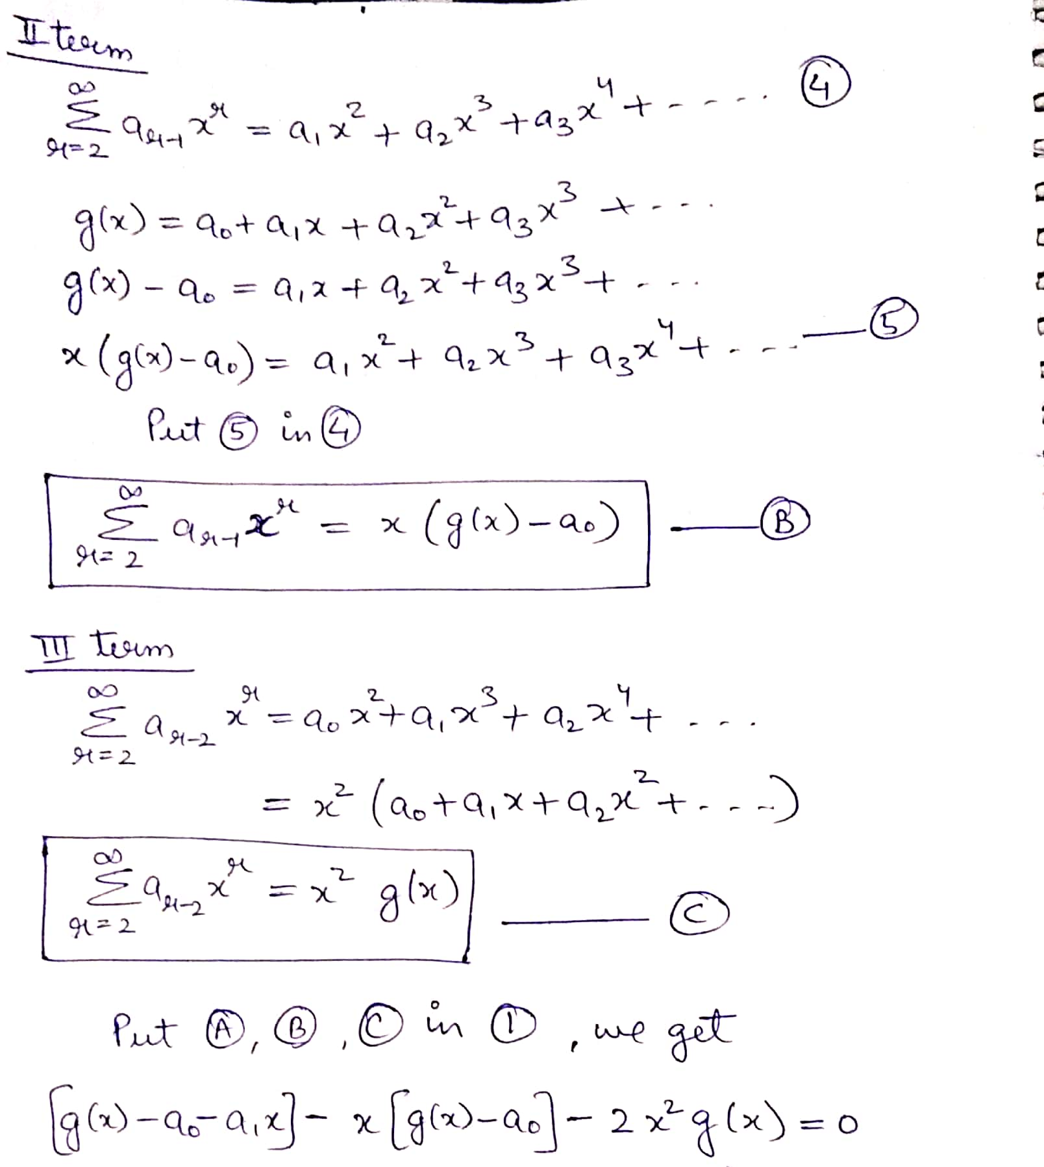
contd..

Slide 21
contd..

Slide 22
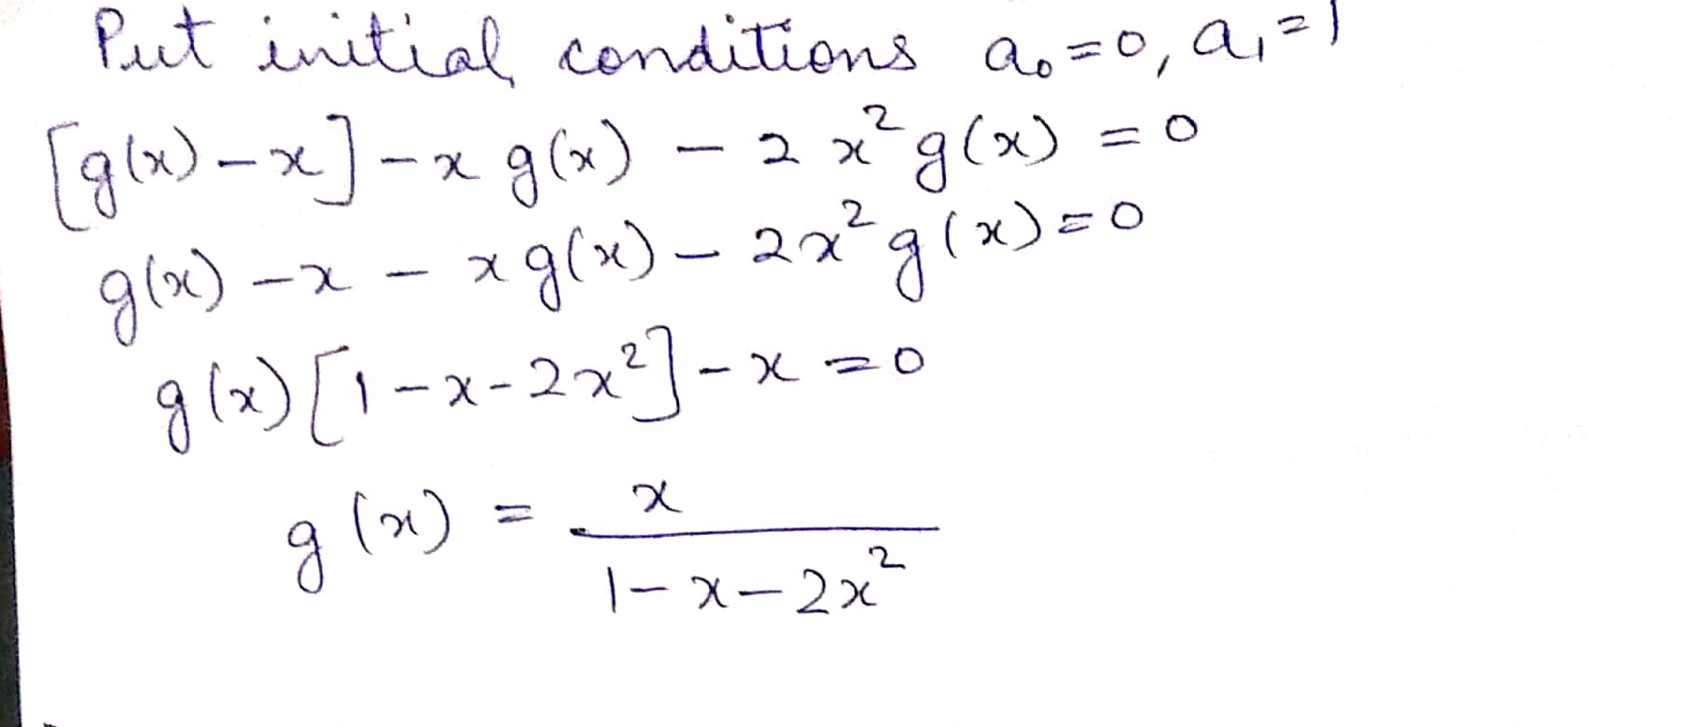
contd..

Slide 23
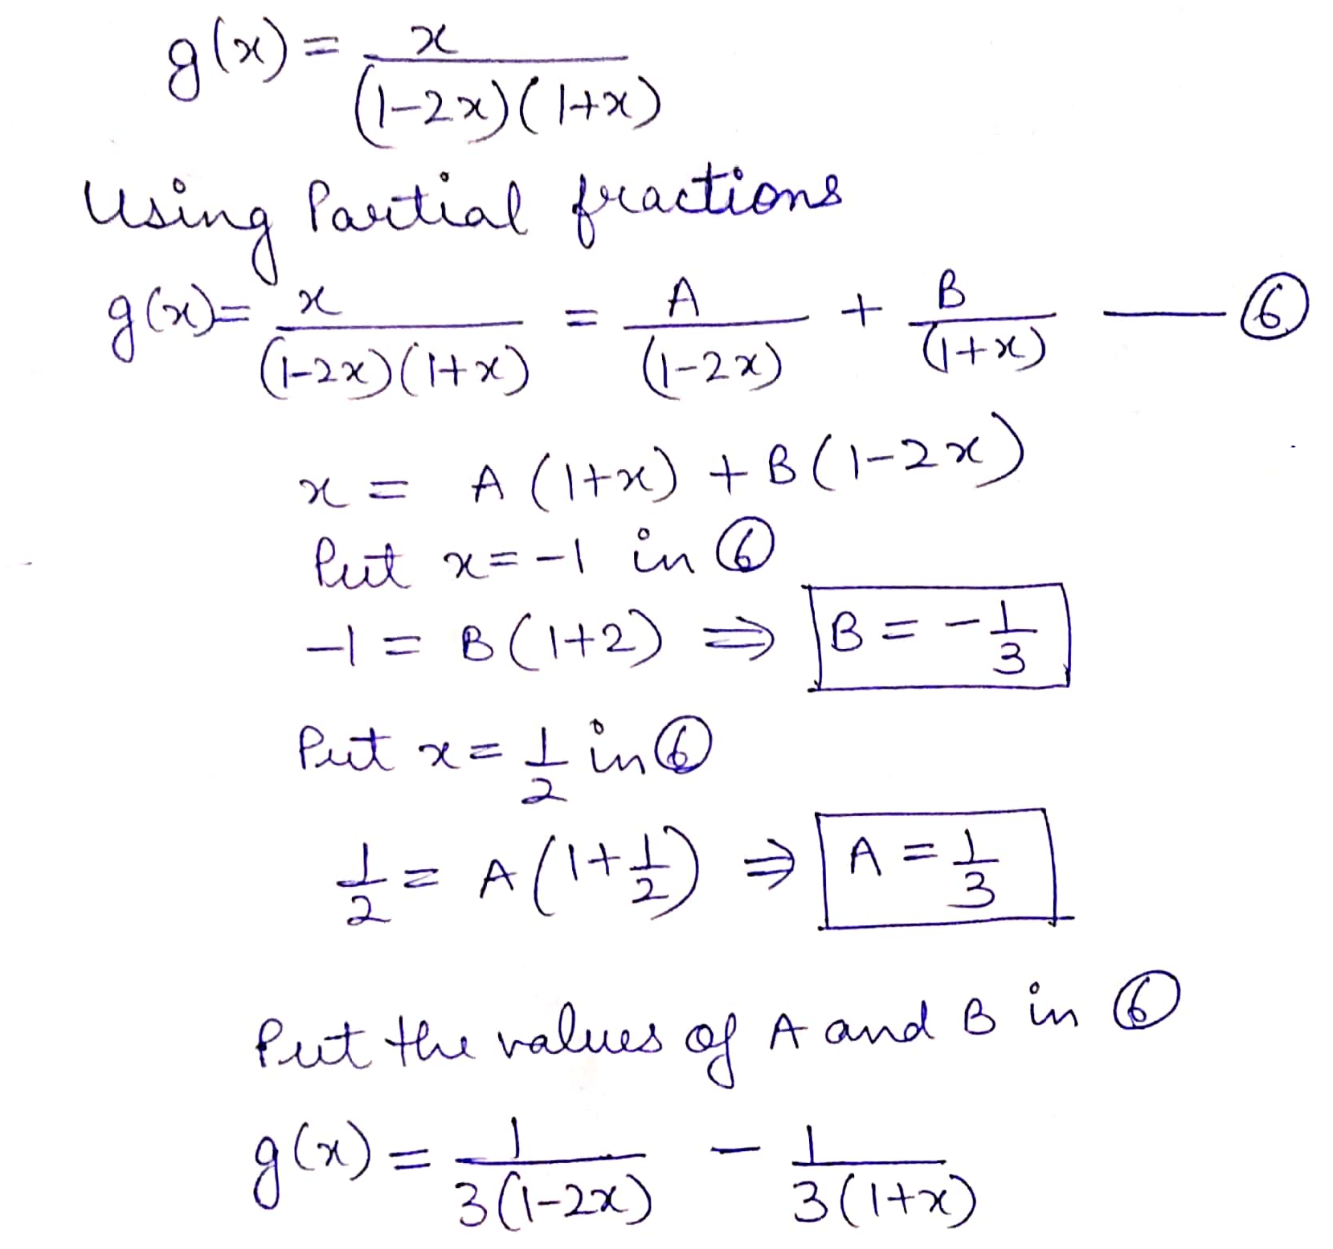
contd..

Slide 24
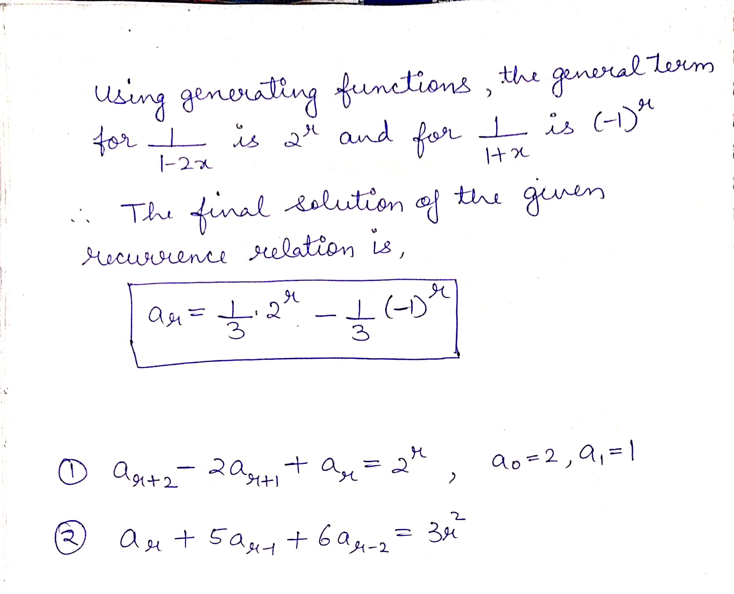

Slide 25
Practice Question

